Slide 1
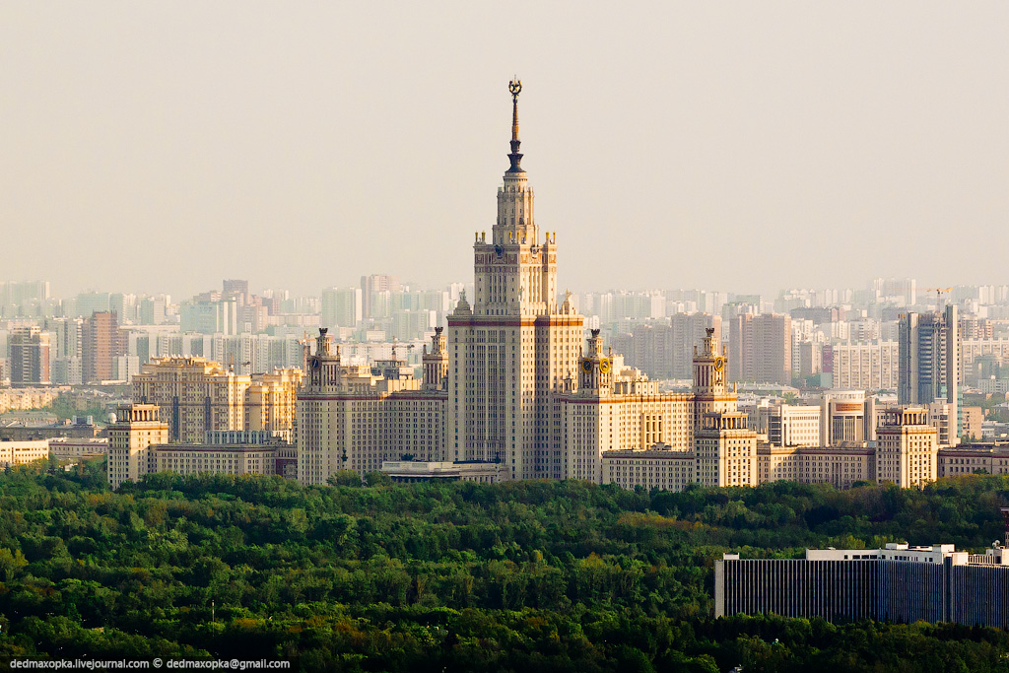
Problems of Regional Modeling and
Mesozoic Geodynamics of the Arctic Region
V.D. Kotelkin¹
¹ Mechmath. Faculty of Lomonosov Moscow State University
MSU December 2014.

Slide 2
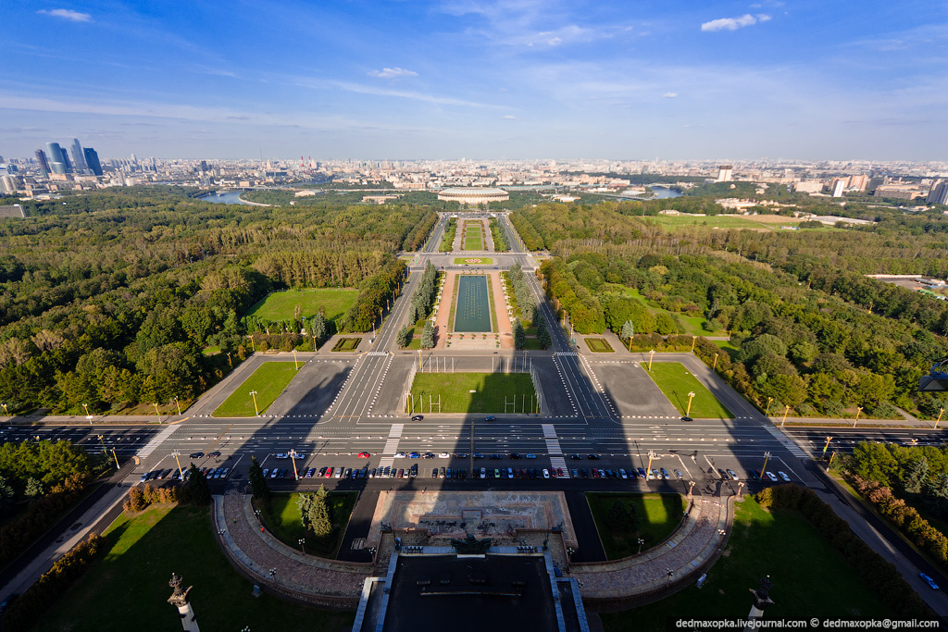
Theoretical Part:
Problems of Regional Modeling
MSU December 2014.

Slide 3
Equations Problem /thermal model/
Thermal convection is ill-posed problem!
It have infinity solutions:
Rectangular cell solutions
v_{z}(x,y,z)=v(z)∙cos(i*x)∙cos(j*y), (i**2 + j**2 = k**2 )
Hexagonal cell solutions
v_{z}(x,y,z)=v(z)∙[2cos(kx/2)∙cos(ky/2) + cos(ky)]

Slide 4
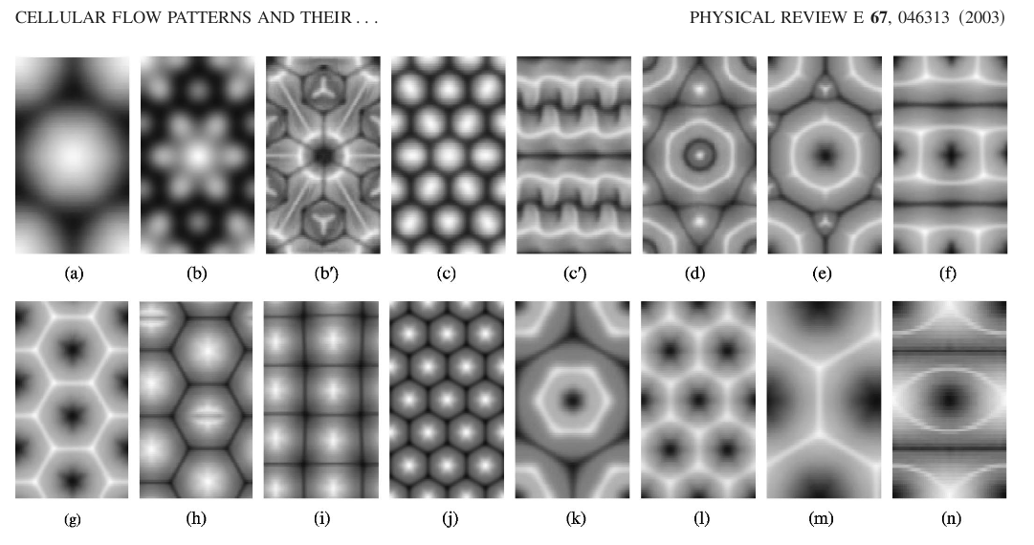
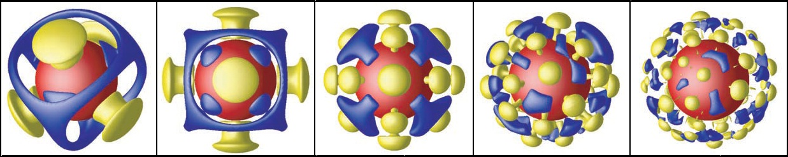
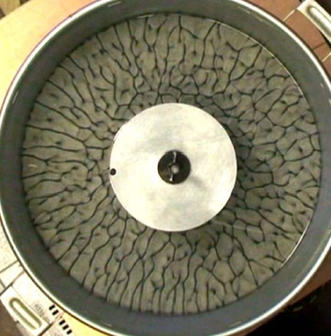
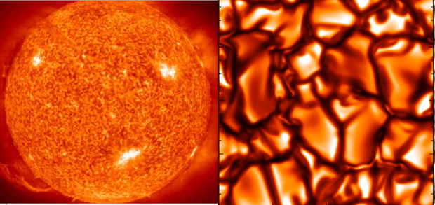
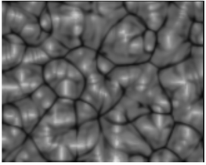
Experiments, Analytics & Numerical Simulation
Regular examples
Chaotic examples

Slide 5
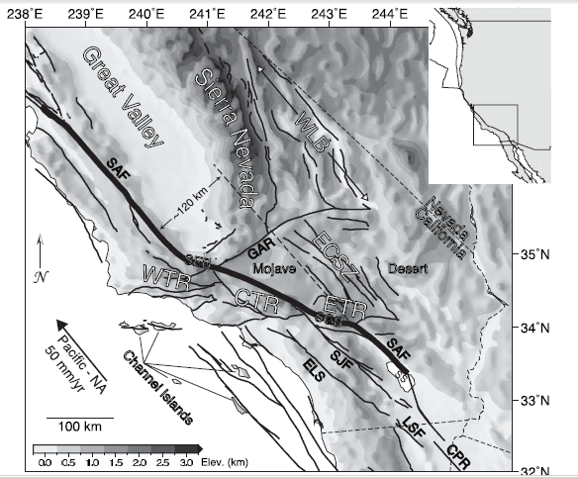
Modern Formulation of the Regional Modeling
Small-scale upper mantle convection
and crustal dynamics in southern California
N. P. Fay, R. A. Bennett, J. C. Spinler and E. D. Humphreys, (2008).
3D Seismic Velocity and Density Structure of the Uppermost Mantle [Karato, 1993].
Numerical Modeling. We solve the three-dimensional equations of conservation of mass and momentum for incompressible
Newtonian viscous flow using the finite element code Gale. The sides and bottom are held fixed.
The model domain is a Cartesian grid 1600 km x 1600 km in map view and extends to 1000 km depth.

Slide 6
Modern Formulation of the Regional Modeling
Three-dimensional numerical modeling of contemporary mantle flow
and tectonic stress beneath the Central Mediterranean
Alik Ismail-Zadeh, Abdelkrim Aoudia, Giuliano F. Panza, (2009).
Density model: ρ=620×Vs+560, Vs – S-wave velocity
Viscosity model: 1.e23 Pa s (upper crust), 1.e19 Pa s (lower crust),
1.e21 Pa s (lithosphere), 1.e22 Pa s (high-velocity lithosphere),
1.e19 Pa s (low-velocity upper mantle), 1.e20 Pa s (asthenosphere).
The viscosities have been reduced by order of one in the regions, where the heat flow is higher than 100 mW/m2, and by two orders of magnitude where the heat flow is higher than 200 mW/m2
Boundary conditions. Free-slip conditions at the upper and lower boundaries of the model domain and symmetry conditions at the vertical boundaries. (Note that free-slip conditions do not allow the upper model boundary to displace vertically). Namely, if the model boundary ∂Ω is impenetrable, the velocity vector satisfies the following conditions at ∂Ω:
We note that no-slip conditions (u=0) at the lower boundary of the model domain will change the flow pattern at the boundary ~30 km thick layer.
Numerical model.
The region under the study is marked by the solid rectangle, and it extends to the depth of 150 km. To minimize boundary effects, this region has been bounded by confining 1°×1° cells (the dotted rectangular) and extended downward to the depth of 350 km (Ω: 1085kmx1085kmx350km). We do not employ heat balance equation and compute stationary instantaneous flow. In this model domain we consider an inhomogeneous viscous flow in the presence of gravity. The flow is described by the momentum (Stokes) equation and the incompressibility condition.

Slide 7
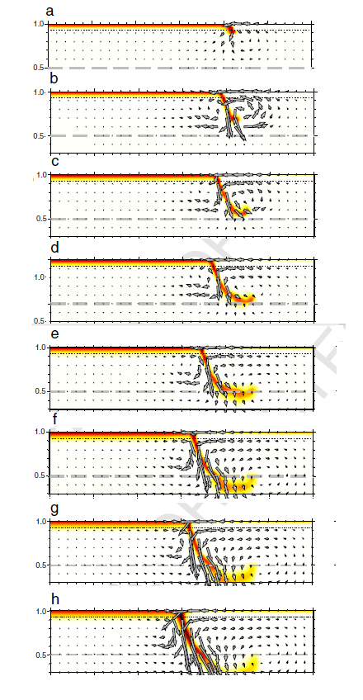
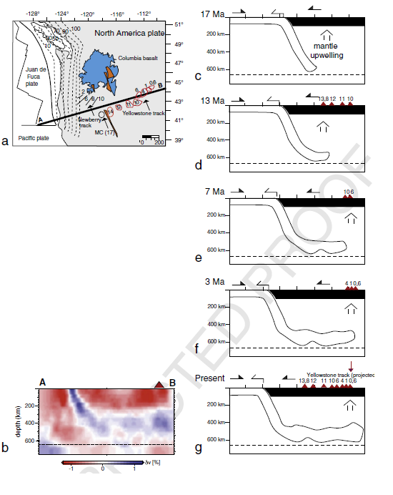
Modern Formulation of the Regional Modeling
Subduction-triggered magmatic pulses: A new class of plumes?
Claudio Faccenna, Thorsten Becker, Serge Lallemand, Yves Lagabrielle,
Francesca Funiciello, Claudia Piromallo, (2010).
We argue that the three-dimensional return flow and slab subduction within the upper mantle can generate focused upwellings and play a significant role in regional tectonics.
The computational domain has dimensions of 3960 km length (x), 1320 km width (y), and 1320 km depth (z).
The mechanical boundary conditions are free slip. The surface temperature is kept at T=0,
and the bottom boundary is zero heat flux.

Slide 8
Linking mantle upwelling with the
lithosphere decent and the Japan Sea evolution: a hypothesis
Ismail-Zadeh, Honda & Tsepelev
NATURE, January 2013

Slide 9
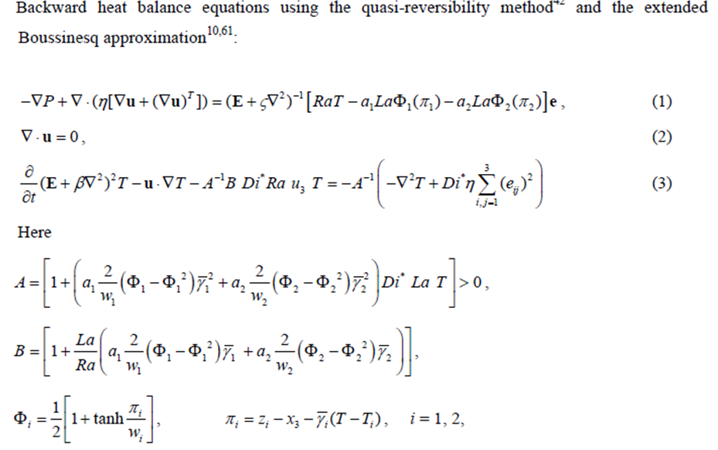

Slide 10
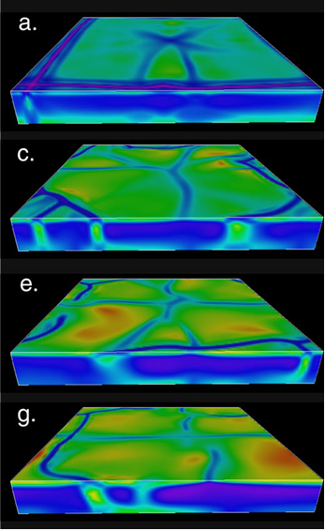
Scientific vs real modeling
P. Tackley
Rectangular Box
Free slip
and zero-flux
conditions at
all boundaries

Slide 11

Contradiction?
Correct seismotomography data must lead to right solution,
but in elliptic problem solution depends from entire area
and can’t be localised (regioned)!
Full solution =
partial nonhomogeneous solution
+ homogeneous solution
Georgy Petrov:
“Ethics
of numerical
Researcher is
very important”
Seismotomography data are guaranteeing only partial solution, which depends from inner structure.
Homogeneous solution is depend from boundary conditions, or outer actions. So when we use Zero-boundary conditions, we delete homogeneous solution

Slide 12
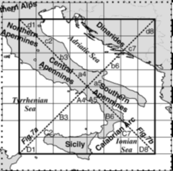
A. Saint-Venant Principle, 1855
In elongated area the forces distribution affects only near boundaries
…but the average force and momentum act into entire area!
Authors: “to minimize boundary
effects, this region has been
bounded by dotted rectangular”.

Slide 13

Problems of Regional Modeling:
General recommendations:
According to the mathematical theory [Tikhonov, Arsenin. “Solutions of Ill-Posed Problems”, NY, 1977], for solution ill-Posed Problem one should add the regularization conditions.
As a boundaries of modelling region should be selected the natural boundaries in the mantle. A rectangular box must cover entire natural region, without partitioning.
It is essential to verify modeling results by independent empiric data, for example seismotomography or geology.
*The worsest is impermeable lower boundary condition,
which are choicing at arbitrary depth (350, 800, 1000, 1320 km).
.

Slide 14
Concrete recommendations
The lower boundary has a most significant influence on result. The strongest natural boundary is the surface that divides the upper and lower mantles, where endothermic phase transition have place. Accordance our investigation [Kotelkin, Lobkovsky, 2011], most time of the Wilson Cycle realizes separate convection.
So we take as impermeable lower boundary the 670 km depth. Of course it is not accurate condition, but with this choice we will have the minimal error.
Moreover we will have good condition for the thermal equation at the lower boundary that the temperature here is equal temperature of phase transition.
As the lower mantle's viscosity is about 30 times more than upper one we use non-slip condition for tangential velocity at lower boundary.
A good decision for the problem of lateral boundaries is a choice natural structures on which mirror boundary conditions are approximately satisfied. These zones are characterized by a clear expressed vertical motion (these are mid-ocean ridges and subduction zones).

Slide 15

Example:Application to 2D-modelling
of the major geodynamic periodicity
Orogenic phases(~60Ma)
are expressed:
in rearrangements of
the direction and speed
the slabs motion
in displacement of
spreading and
subduction zones
in the change
of processes
in Benioff zones
in producing of
ophiolites and granite
in volcanism and metamorphism.
South Pacific Slab Conference. Fiji, February 2014.

Slide 16
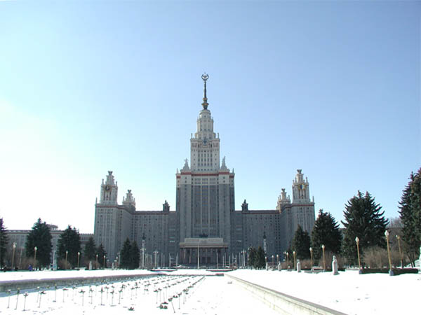
Application of the
Arctic Region Modeling
MSU December 2014

Slide 17
Geological Model of Arctic Evolution
According to geological data*, there was an ancient (Neoproterozoic) continent – ‘Arctida’. During tithonian-aptian time (150 -110 Ma ago) there existed two active zones of subduction – PaleoAnyui and Pacific. At that time the ‘Chukotka – Alaska’ microplate was break off from the Canadian Arctic Archipelago and collision with Eurasia. So was open the Canadian Basin and closed the South Anyui paleocean.
After the PaleoAnyui subduction ceased to exist, only Pacific zone continues to be active. Hence southward motion of fragments an ancient continent was redirected to
the east, by this reason in the Cenozoic was formed the Eurasian Basin.
* Lobkovsky, Garagash, Kononov, Verzhbitsky, Kotelkin
Tectonics of Deforming Lithosphere Plates and Mz-Kz geodynamics of Arctic Region.
Moscow: GEOS, 2010. Vol. 2, pp. 8-40 (in Russian).

Slide 18
Numerical Models
Step 1. Upper mantle convection modeling (Slava Kotelkin)
Rectangular Box with
Free slip condition
at outer boundary and
subduction zones position
as regularization conditions
Step 2. Plate deformation modeling (Igor Garagash)
Use Code FLAC 3D for
nonlinear elastic-plastic flow
were calculated destructions
associated with the excess of the
limits of the tensile and shear.

Slide 19
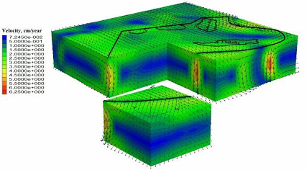
Numerical Modeling of Upper Mantle Convection
3D-numerical simulations have been applied to check geodynamic evolution of the Arctic region at 150-110 Ma. At first, we simulated convection in the upper mantle. As the regularization condition we used the position of PaleoAnyui and Pacific subduction zones. Further we introduced forces, which supported downwelling flow in these zones. We applied the model of thermal convection in the viscous medium in the Boussinesq approximation with the temperature dependence of viscosity by I.Karato.

Slide 20
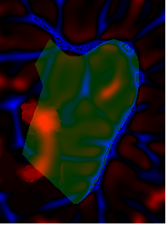
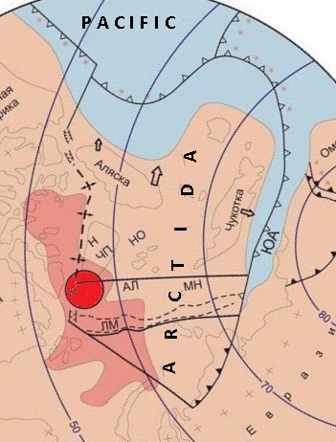
The Regional Modeling Control
We postulated position of solely downwelling flows, so we can control our modeling through upwelling flow. The calculated position of upwelling flow shall match a plum position known from geological data.
Up velocity divergence

Slide 21
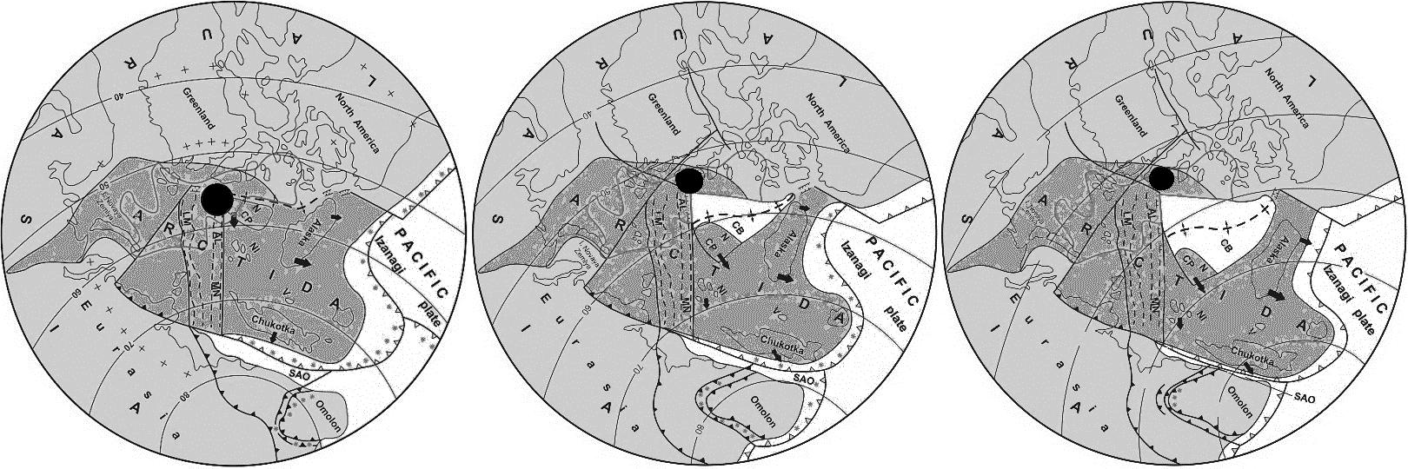
Geological Reconstructions
150 Ma ago
140 Ma ago
130 Ma ago

Slide 22
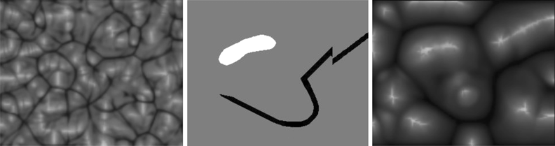
Regularization
Convection
without regularization
Conditions of Regularization
Convection
with regularization
Calculation on homogenous Cartesian mesh 320х256х32 cells, λ=5.

Slide 23
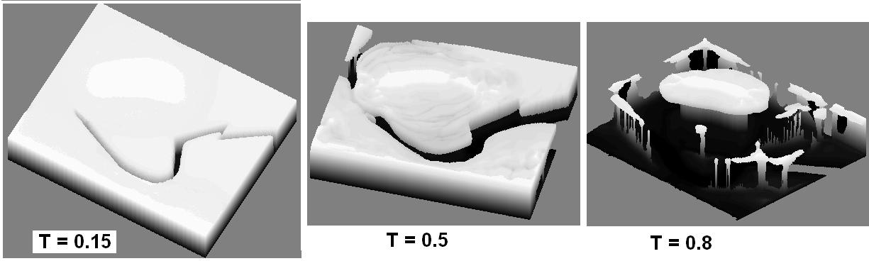
3D-Result. Isothermal Surfaces*
*V. D. Kotelkin, L. I. Lobkovskii Modeling of Regional Geodynamics Using Geological Data
Doklady Earth Sciences, 2013, Vol. 450, Part 1, pp. 521–525.

Slide 24
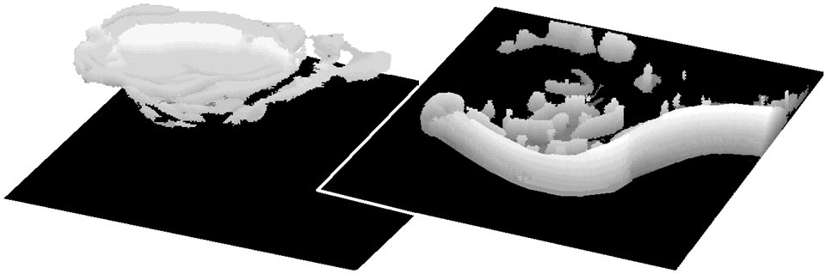
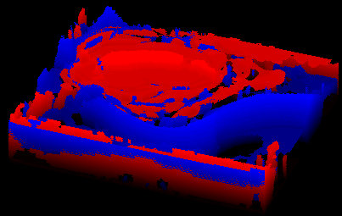
3D-Result.
(Up & Down)Velocity Distribution*
*V. D. Kotelkin, L. I. Lobkovskii Regularization of Geodynamic Problems Using Geological Data.
// Fluid Dynamics 2014, Vol. 49, No 3, pp. 310-319.

Slide 25
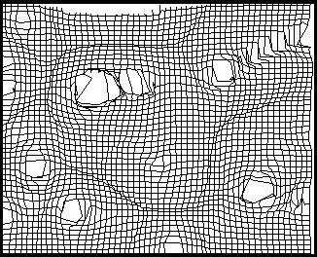
Surface’s Mesh Deformation

Slide 26
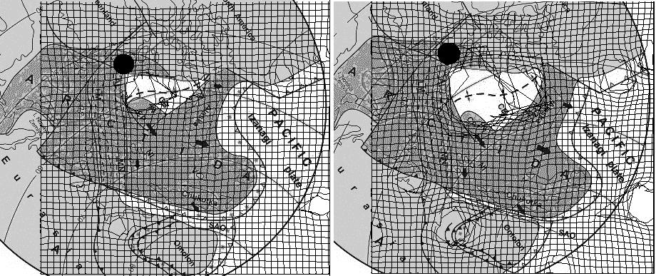
Numerical Modeling and
Geological Reconstruction

Slide 27
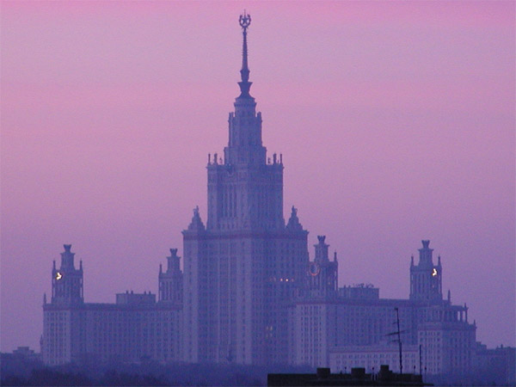
CONCLUSIONS
1. Regional modeling is ill-posed problem, that needs regularization conditions.
2. To get objective results one need to limit an explored region by some natural boundaries. As a lower natural boundary one might take the phase boundary at 670 km. Side boundaries stay uncertain, so it is preferable to formulate soft conditions at them.
3. To get objective results it is useful to add actual geological information about the position of subduction zones or plums.
4. Verifying modeling results by independent empiric data is essential.
5. In accordance with the geological data checked by numerical modeling, the Arctic region evolution has gone 2 stages destruction of an ancient ‘Arctida’ continent with formation at first of the Amerasian and then of the Eurasian basin.
MSU December 2014

Slide 28
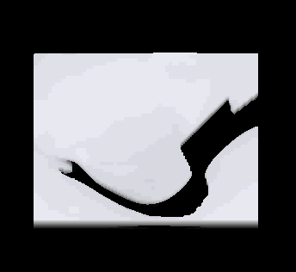
THANK YOU FOR ATTENTION !

